Slide 1
ECEG-4191 Database Systems
Chapter 01
Introduction

Slide 2
Database Applications
Businesses: Banking, Insurance, Retail, Transportation, Healthcare, Manufacturing
Service industries: Financial, Real-estate, Legal, Electronic Commerce, Small businesses
Education : Resources for content and Delivery
Recently:
Social Networks, Environmental and Scientific Applications, Medicine and Genetics
Personalized applications: based on smart mobile devices
…. The list goes on!

Slide 3
Basic Definitions
data.
- Database is a collection of related _______
known facts that can be recorded and have an implicit meaning.
- Data: ______________________________________________________
A catalog that stores the description of a particular database
- Meta-data: ______________________________________________________
Database Management System (DBMS):
A software package/system to facilitate the creation and maintenance of a computerized database.
Database System:
The DBMS software together with the data itself. Sometimes, the application programs and interfaces are also included.
A Database System models a real world enterprise (mini world):
Entities
_____________ (e.g., students, courses)
Relationships
_____________ (e.g., John is takes ECEG 4191)
Notes:
Meta data stores (data structures, types, and constraints)

Slide 4
File System v.s. DBMS
File System is a collection of individual ____ accessed by application programs.
files
Example: Store the data in comma-separated value (CSV) files.
Use a separate file per entity.
Write applications to access and manipulate this data as they are needed
File Approach
Database Approach (SQL)
Procedure FindStudent;
begin
open file Student.txt; Line=ReadLine();
While not EOF(Student)
Student = ParseStudent(Line);
If Student.name='Bart' then display(Student);
EndIf
Read(Student);
EndWhile;
End;
SELECT *
FROM Students
WHERE
name = 'Bart'

Slide 5
Limitation of Traditional File Based Systems
- Data Redundancy and Inconsistency
data is stored in multiple file formats resulting in duplication of information in different files
- Difficulty in Accessing Data
Need to write a new program to carry out each new task
- Data Isolation
Multiple files and formats
- Integrity Problems
Integrity constraints (e.g., account balance > 0) become “buried” in program code rather than being stated explicitly
Hard to add new constraints or change existing ones
- Schema Change
requires changing file formats
need to rewrite virtually all applications
Notes:
5

Slide 6
Limitation of Traditional File Based Systems (Cont.)
Atomicity of updates
Failures may leave database in an inconsistent state with partial updates carried out
Example: Transfer of funds from one account to another should either complete or not happen at all
Concurrent access by multiple users
Concurrent access needed for performance
Uncontrolled concurrent accesses can lead to inconsistencies
Ex: Two people reading a balance (say 100) and updating it by withdrawing money (say 50 each) at the same time
Security problems: Problems of fine-grained, content-based access control
Hard to provide user access to some, but not all, data.
Password/file-based authorization insufficient
Notes:
6

Slide 7
Disadvantages of Traditional File Based Systems
Data redundancy - wasted space
Update issues – every copy of the data needs to be modified
Data inconsistency – sometimes every copy is not modified
Data access issues (getting to just the right data)
“There’s no program for that.”
Data isolation - pulling all the data from disparate sources together)
Integrity constraints buried in application logic – hard to add to or change
Atomicity problems – what happens when the system crashes during an important operation?
Concurrency issues – when multiple users work with the same data at the same time
Security issues – how to give someone access to some, but not all, of the data

Slide 8
Main Characteristics of the Database Approach (cont.)
Self-describing nature of a database system:
A DBMS catalog stores the description of a particular database (e.g. data structures, types, and constraints)
The description is called meta-data.
Insulation between programs and data:
Called program-data independence.
Allows changing data structures and data storage organization without having to change the DBMS access programs.
Accomplished through data abstraction
A data model is used to hide storage details and present the users with a conceptual view of the database.
Programs refer to the data model constructs rather than data storage details

Slide 9
Why Use a DBMS(1)
Insulation between programs and data(a.k.a. Data Independence)
Allows changing data structures and data storage organization without having to change the DBMS access programs.
Efficient access
Data Administration
Data Integrity: Enforcing integrity constraints on the database.
Recovery From Crashes: Providing backup and recovery services.
Concurrent Access
Allowing a set of user transactions to access and update the database concurrently.
Security: Restricting unauthorized access to data.
Notes:
Accomplished through data abstraction
A data model is used to hide storage details and present the users with a conceptual view of the database.
Programs refer to the data model constructs rather than data storage details
Concurrency control within the DBMS guarantees that each transaction is correctly executed or aborted
Recovery subsystem ensures each completed transaction has its effect permanently recorded in the database
OLTP (Online Transaction Processing) is a major part of database applications (allows hundreds of concurrent transactions to execute per second)

Slide 10
Why Use a DBMS(2)
Potential for Enforcing Standards:
Crucial for the success of database applications in large organizations.
Reduced application development time:
The time needed to add each new application is reduced.
Flexibility to change data storage structures:
Storage structures may evolve to improve performance, or because of new requirements.
Availability of up-to-date information:
Extremely important for on-line transaction systems such as airline, hotel, car reservations.
Economies of scale:
Wasteful overlap of resources and personnel can be avoided by consolidating data and applications across departments.
… The list goes on! Read the text book.

Slide 11
Why Use a DBMS
Controlling redundancy in data storage and in development and maintenance efforts.
Sharing of data among multiple users.
Providing persistent storage for program Objects (In Object-oriented DBMSs)
Providing Storage Structures (e.g. indexes) for efficient Query Processing
Providing multiple interfaces to different classes of users.
Representing complex relationships among data.
Drawing inferences and actions from the stored data using deductive and active rules
Allowing multiple “views” of the same data

Slide 12
Typical DBMS Functionality
data types
structures
constraints
Define a particular database in terms of its __________, _________, and __________
Construct or Load the initial database contents on a secondary storage medium (typically hard disk)
Manipulate the database:
Retrieval
___________________
Querying (selection)
Modification
_________________________________________
Insertions, deletions and updates to its content
Accessing/changing the database through Web/Desktop applications
Processing and Sharing by a set of concurrent users and application programs – yet, keeping all data valid and consistent
… The list goes on! Read the text book.

Slide 13
Typical DBMS Functionality (cont.)
Other features:
Protection or Security measures to prevent unauthorized access
“Active” processing to take internal actions on data
Presentation and Visualization of data
Maintaining the database and associated programs over the lifetime of the database application(system to evolve as requirements change over time)
Called database, software, and system life-cycle maintenance

Slide 14
Types of Database Applications
Traditional Applications:
Numeric and Textual Databases in Business Applications
More Recent Applications:
Multimedia Databases (images, videos, voice, etc.)
Geographic Information Systems (GIS)
store and analyze maps, weather data, and satellite images
Data Warehouses
extract and analyze useful business information from very large databases to support decision making
Real-time and Active Databases
control industrial and manufacturing processes.
Many other applications
Notes:
Initial part of book focuses on traditional applications
A number of recent applications are described later in the book (for example, Chapters 26,27,28,29)
These interactions are examples of what we may call traditional database applications, in which most of the information that is stored and accessed is either textual or numeric. In the past few years, advances in technology have led to exciting new applications of database systems. The proliferation of social media Web sites, such as Facebook, Twitter, and Flickr, among many others, has required the creation of huge databases that store nontraditional data, such as posts, tweets, images, and video clips.
New types of database systems, often referred to as big data storage systems, or NOSQL systems, have been created to manage data for social media applications. These types of systems are also used by companies such as Google, Amazon, and Yahoo, to manage the data required in their Web search engines, as well as to provide cloud storage, whereby users are provided with storage capabilities on the Web for managing all types of data including documents, programs, images, videos and emails.

Slide 15
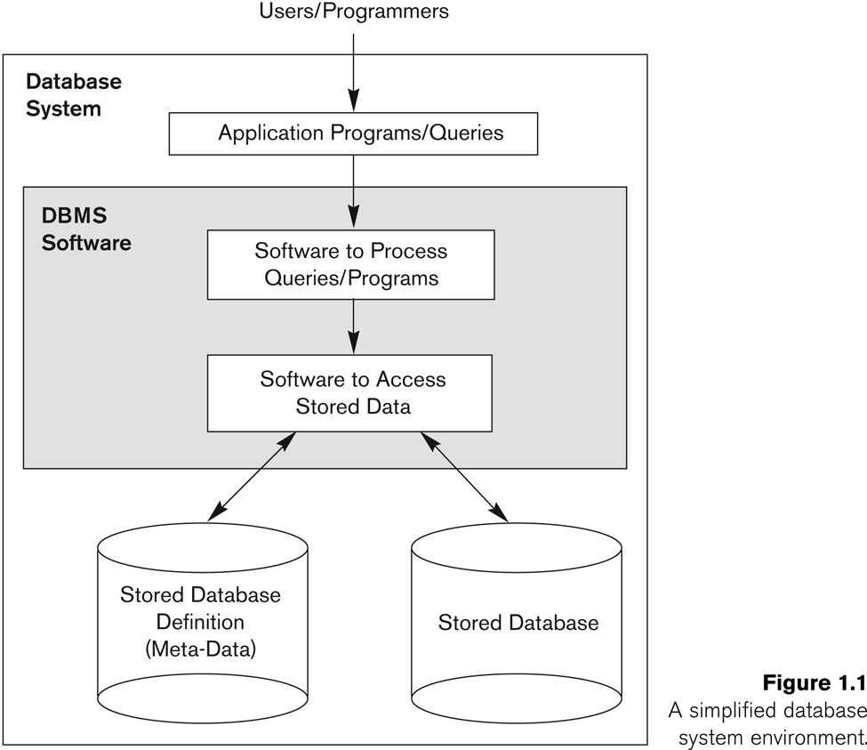
Simplified Database System Environment

Slide 16
Multi-User DBMS
Types of Database Users
Actors on the Scene:
Those who actually use and control the database content, and those who design, develop and maintain database applications.
Workers Behind the Scene
Those who design and develop the DBMS software and related tools, and the computer systems operators.

Slide 17
Database Users: DB Administrators (DBAs) and Designers
Database Administrators:
Responsible for authorizing/controlling access to the database; coordinating and monitoring its use; acquiring software and hardware resources; and monitoring efficiency of operations.
Database Designers:
Responsible for defining database structure, constraints, and transactions; communicate with users to understand their needs.

Slide 18
Database Users: End-users
End-users: use the database for queries, reports, and updating the database content. Can be categorized into:
Casual end-users
Access database occasionally when needed
Naïve (or Parametric) end-users
Use previously implemented and tested programs (called “canned transactions”) to access/update the database.
Examples are bank-tellers or hotel reservation clerks or sales clerks.
Sophisticated end-users:
These include business analysts, scientists, engineers, others thoroughly familiar with the system capabilities.
Many use tools in the form of software packages that work closely with the stored database.
Stand-alone end-users:
Mostly maintain personal databases using ready-to-use packaged applications.
An example is a tax program user that creates its own internal database.
Another example is a user that maintains an address book.
Notes:
Naïve (or Parametric) end-users: largest section of end-user population.

Slide 19
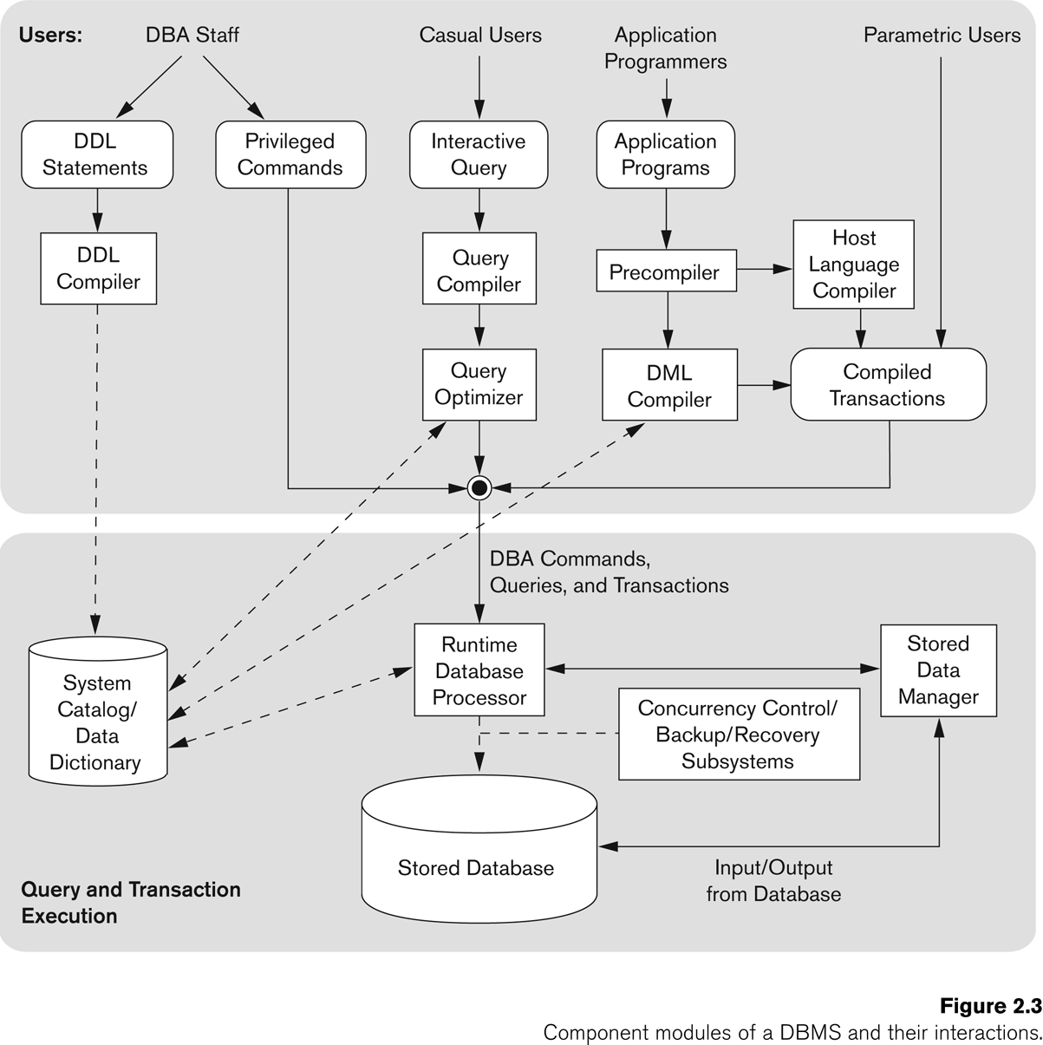
A simplified architecture for a database system

Slide 20
Three-Schema Architecture
Proposed to support DBMS characteristics of:
Program-data independence.
Support of multiple views of the data.
Defines DBMS schemas at three levels:
Internal schema at the internal level to describe physical storage structures and access paths (e.g indexes).
Typically uses a physical data model.
Conceptual(logical) schema at the conceptual level to describe the structure and constraints for the whole database for a community of users.
Uses a conceptual or an implementation data model.
External schemas at the external level to describe the various user views.
Usually uses the same data model as the conceptual schema.
Levels of Abstraction
This is also known as the ANSI/SPARC (American National Standards Institute/ Standards Planning And Requirements Committee) architecture, after the committee that proposed it (Tsichritzis & Klug, 1978).
Notes:
Note: Not explicitly used in commercial DBMS products, but has been useful in explaining database system organization.

Slide 21
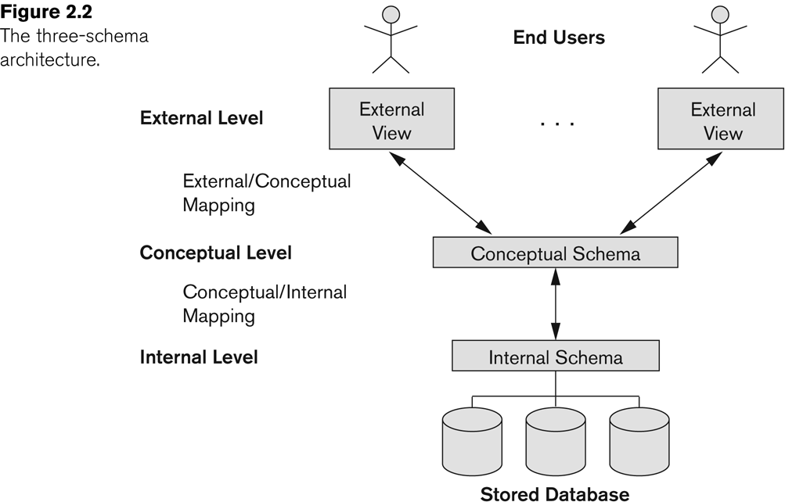
Three-Schema(ANSI-SPARC) Architecture
Proposed to support DBMS characteristics of:
Program-data independence.
Support of multiple views of the data.
Defines DBMS schemas at three levels:
Internal schema at the internal level to describe physical storage structures and access paths (e.g indexes).
Typically uses a physical data model.
Conceptual schema at the conceptual level to describe the structure and constraints for the whole database for a community of users.
Uses a conceptual or an implementation data model.
External schemas at the external level to describe the various user views.
Usually uses the same data model as the conceptual schema.
Notes:
Note: Not explicitly used in commercial DBMS products, but has been useful in explaining database system organization.

Slide 22
The three-schema(ANSI-SPARC) architecture
Includes views used to control data access and enforce security
Contains the conceptual and logical data models. E.g., tables
Includes the internal data model. E.g., Index
Changes in one layer should have no to minimal impact on the others
Physical data independence
Logical data independence
Notes:
Mappings among schema levels are needed to transform requests and data.
Programs refer to an external schema, and are mapped by the DBMS to the internal schema for execution.
Data extracted from the internal DBMS level is reformatted to match the user’s external view (e.g. formatting the results of an SQL query for display in a Web page)

Slide 23
Data Independence
Logical Data Independence:
The capacity to change the conceptual schema without having to change the external schemas and their associated application programs.
Physical Data Independence:
The capacity to change the internal schema without having to change the conceptual schema.
In a DBMS that fully supports data independence.
When a schema at a lower level is changed:
only the mappings between the schema and higher-level schemas need to be changed
Notes:
For example, the internal schema may be changed when certain file structures are reorganized or new indexes are created to improve database performance.
The higher-level schemas themselves are unchanged.
Hence, the application programs need not be changed since they refer to the external schemas.

Slide 24
Historical Development of Database Technology
Early Database Applications:
The Hierarchical and Network Models were introduced in mid 1960s and dominated during the seventies.
Some worldwide database processing still occurs using these models; particularly, the hierarchical model.
Relational Model based Systems:
Relational model was introduced in 1970, and heavily researched and experimented with at IBM Research and several universities.
Relational DBMS Products emerged in the early 1980s and now dominate the market.
Object-oriented and emerging applications:
Object Databases (ODBs) were introduced in late 1980s and early 1990s to cater to the need of complex data and applications, and the proliferation of object-oriented programming languages.
Their use has not taken off much.
Many relational DBMSs have incorporated object database concepts, leading to a new category called object-relational databases (ORDBs)
Extended relational systems add further capabilities (e.g. for multimedia data, XML, spatial, and other data types)

Slide 25
Lifecycle of Data 4 “A”s
Acquisition
Aggregation
Analysis
Application
Log
Data
Scattered
Data
Integrated
Data
Knowledge

Slide 26
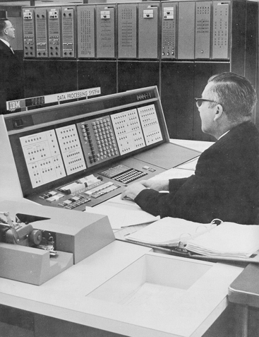
What: Database Systems Then

Slide 27
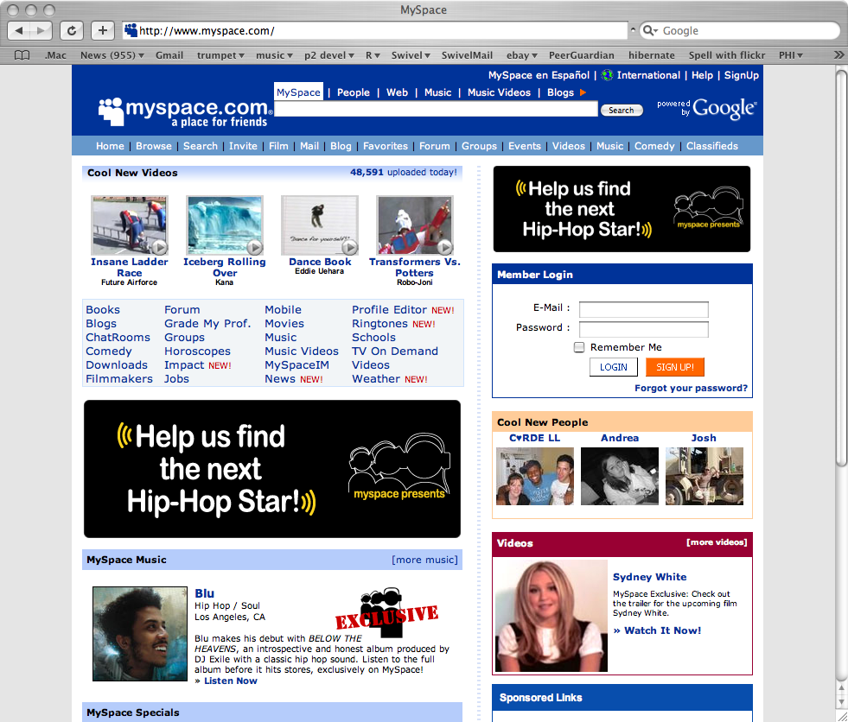
What: Database Systems Today

Slide 28
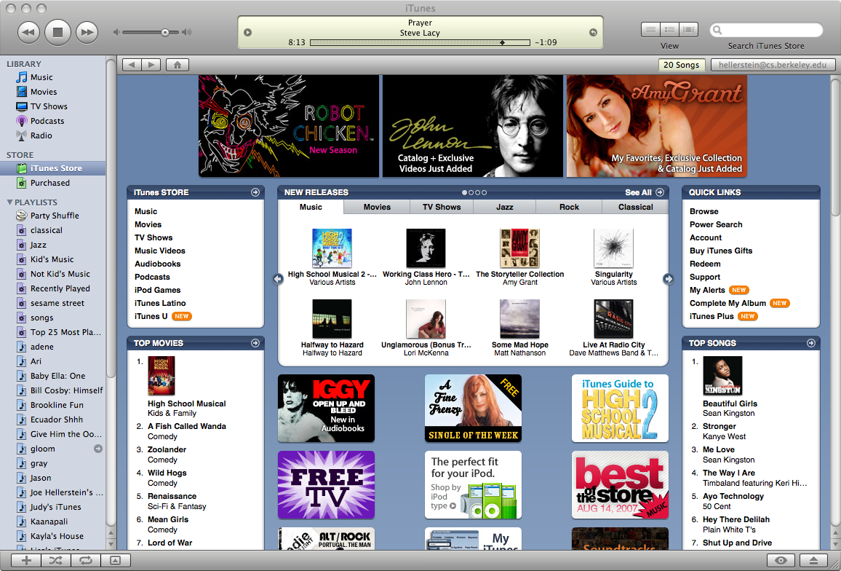
What: Database Systems Today

Slide 29
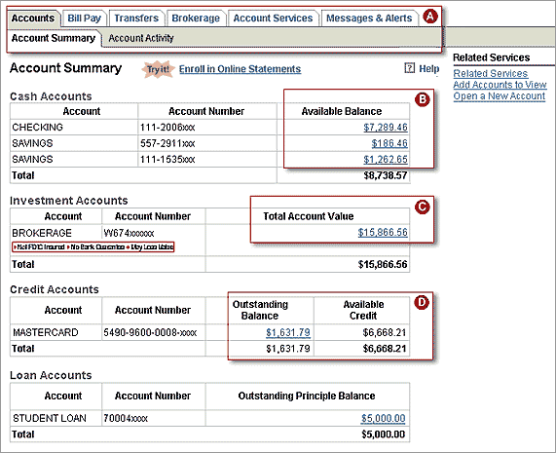
What: Database Systems Today

Slide 30
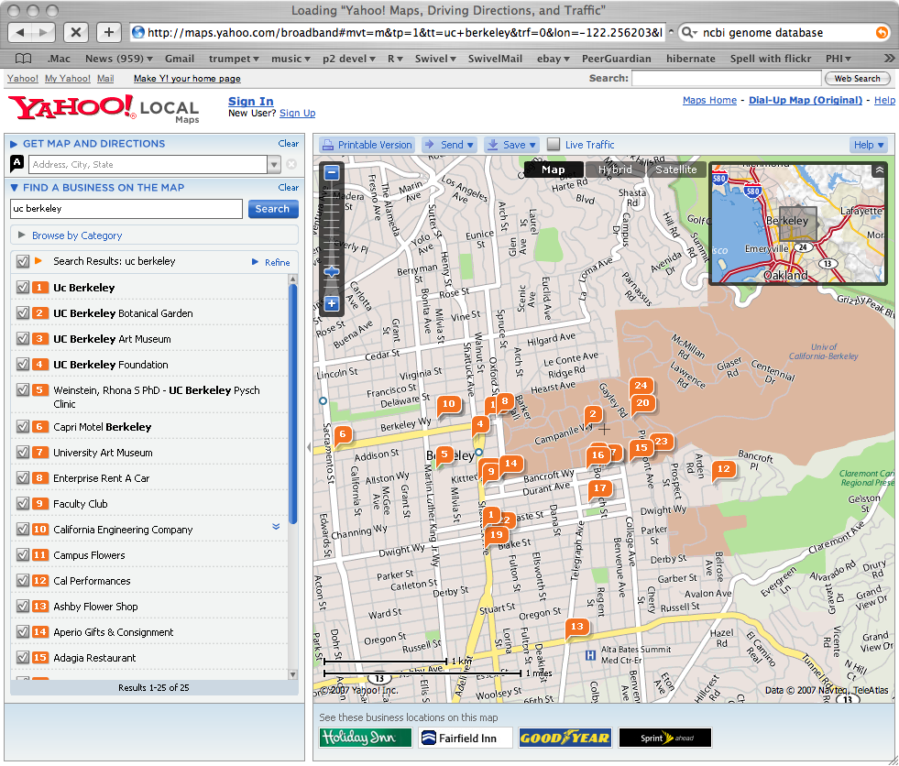
What: Database Systems Today

Slide 31
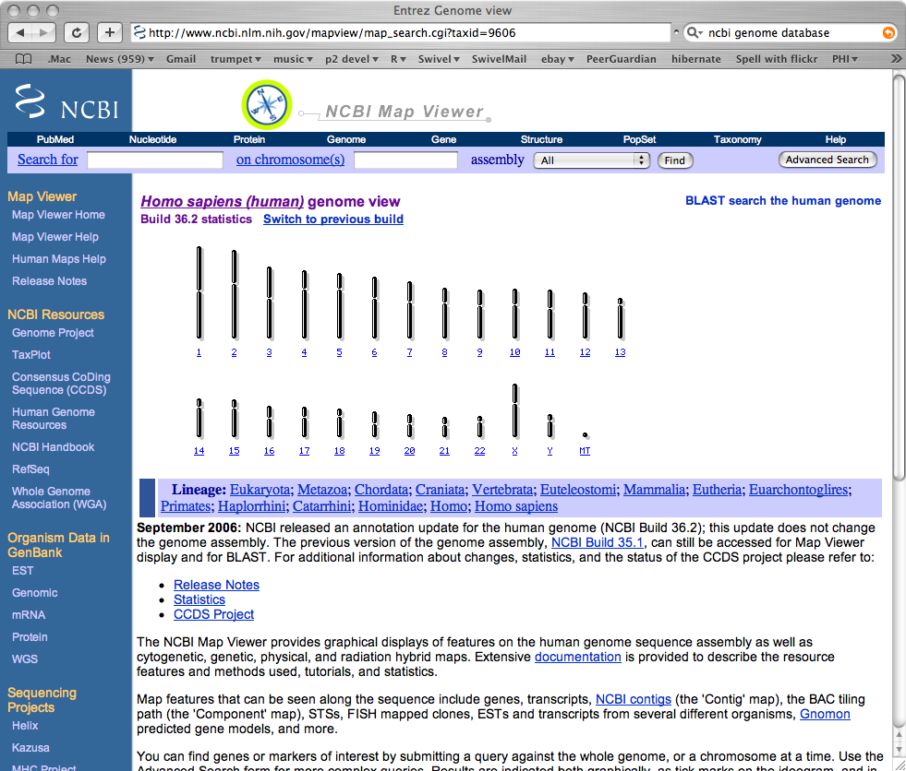
What: Database Systems Today

Slide 32
Recent Developments (1)
Social Networks started capturing a lot of information about people and about communications among people-posts, tweets, photos, videos in systems such as:
- Facebook
- Twitter
- Linked-In
All of the above constitutes data
Search Engines, Google, Bing, Yahoo: collect their own repository of web pages for searching purposes

Slide 33
Recent Developments (2)
New technologies are emerging from the so-called non-SQL to manage vast amounts of data generated on the web:
Example: NOSQL (Non-SQL, Not Only SQL) systems (Chapter 24)
A large amount of data now resides on the “cloud” which means it is in huge data centers using thousands of machines.

Slide 34
Why is “big data” a “big deal”?
Private Sector
Walmart handles more than 1 million customer transactions every hour, which is imported into databases estimated to contain more than 2.5 petabytes of data
Facebook handles 40 billion photos from its user base
Falcon Credit Card Fraud Detection System protects 2.1 billion active accounts world-wide
Science
Large Synoptic Survey Telescope will generate 140 Terabyte of data every 5 days
Biomedical computation like decoding human Genome and personalized medicine

Slide 35
When not to use a DBMS
Cost of using a DBMS:
High initial investment and possible need for additional hardware.
Overhead for providing generality, security, concurrency control, recovery, and other functions.
When a DBMS may be unnecessary:
If the database and applications are simple, well defined, and not expected to change.
If there are stringent real-time requirements that may not be met because of DBMS overhead.
If access to data by multiple users is not required.
When no DBMS may suffice:
If the database system is not able to handle the complexity of data because of modeling limitations
If the database users need special operations not supported by the DBMS
When DBMS overhead makes it impossible to achieve the needed application performance

